Slide 1
Recap: Lecture 13: 10th Feb 2014, 1130-1230 hrs.
Thermodynamic temperature scale
Carnot heat engine
Quality of energy
Carnot refrigerator and heat pump
Clausius inequality
Property of entropy
T-s entropy
Isentropic processes

Slide 2
Clausius inequality
Clausius inequality provides the criterion for the irreversibility of a process.

Slide 3
Clausius inequality and entropy
The cyclic integral of work and heat are not zero.
However, the cyclic integral of volume (or any other property) is zero.
Conversely, a quantity whose cyclic integral is zero depends on the state only and not the process path, and thus it is a property
Clausius realized in 1865 that he had discovered a new thermodynamic property, and he chose to name this property entropy.

Slide 4
The property of entropy
_{P}
_{a}
R₂
R₁
R₂
_{b}
R₁
R₂
R₁
_{V}
R₁
R₂

Slide 5
The property of entropy
is independent of the reversible path connecting a and b.
This property whose value at the final state minus the initial state is equal to is called entropy, denoted by S.
When the two equilibrium states are infinitesimally near,
R
R
R

Slide 6
Entropy
Entropy is an extensive property of a system and sometimes is referred to as total entropy. Entropy per unit mass, designated s, is an intensive property and has the unit kJ/kg·K
The entropy change of a system during a process can be determined by

Slide 7
Entropy
Entropy is a property, and like all other properties, it has fixed values at fixed states.
Therefore, the entropy change dS between two specified states is the same no matter what path, reversible or irreversible.

Slide 8
Temperature-entropy plot
A reversible adiabatic process is, therefore, and isentropic process.

Slide 9
Temperature-entropy plot
T
a
Reversible path
b
S_{a}
dS
S_{b}
S
The area under the reversible path on the T-S plot represents heat transfer during that process.

Slide 10
Isentropic processes
A process where, Δs=0
An isentropic process can serve as an appropriate model for actual processes.
Isentropic processes enable us to define efficiencies for processes to compare the actual performance of these devices to the performance under idealized conditions.
A reversible adiabatic process is necessarily isentropic, but an isentropic process is not necessarily a reversible adiabatic process.

Slide 11
Entropy change and entropy generation
Consider a cycle made up of two processes (1-2 and 2-1)
_{y}
Internally reversible
process
₁
₂
Reversible or
Irreversible process
_{x}

Slide 12
Entropy change and entropy generation
The second integral is equal to entropy change during that process.
Here, the equality holds for an internally reversible process and the inequality for an irreversible process.

Slide 13
Entropy change and entropy generation
The entropy change of a closed system during an irreversible process is greater than the integral of δQ/T evaluated for that process.
In the limiting case of a reversible process, these two quantities become equal.
Note: T in these relations is the temperature at the boundary where the differential heat δQ is transferred between the system and the surroundings.

Slide 14
Entropy change and entropy generation
Inequality sign: entropy change of a closed system during an irreversible process is always greater than the entropy transfer.
Some entropy is generated or created during an irreversible process, and this generation is entirely due to the irreversibilities.
This entropy generated during a process is called entropy generation and is denoted by S_{gen.}

Slide 15
Entropy change and entropy generation
The entropy generation S_{gen} is always a positive quantity or zero.
Its value depends on the process, and thus it is not a property of the system.
For an isolated system (or simply an adiabatic closed system), the heat transfer is zero.

Slide 16
Increase of entropy principle
The entropy of an isolated system during a process always increases or, in the limiting case of a reversible process, remains constant.
This is known as the increase of entropy principle.
In the absence of any heat transfer, entropy change is due to irreversibilities only, and their effect is always to increase entropy.

Slide 17
Increase of entropy principle
The entropy of the universe is continuously increasing.
No entropy is generated during reversible processes.
The increase of entropy principle does not imply that the entropy of a system cannot decrease.
The entropy change of a system can be negative during a process, but entropy generation cannot.

Slide 18
Increase of entropy principle
A system and its surroundings form an isolated system.

Slide 19
Increase of entropy principle
Processes can occur in a certain direction only, not in any direction.
A process must proceed in the direction that complies with the increase of entropy principle, that is, S_{gen} ≥ 0.
Entropy is a non-conserved property, and there is no such thing as the conservation of entropy principle.
Entropy is conserved during the idealized reversible processes only and increases during all actual processes.

Slide 20

Increase of entropy principle
1
2
4
N
3
...
5
The entropy change of an isolated system is the sum of the entropy changes of its components, and is always greater than zero.

Slide 21
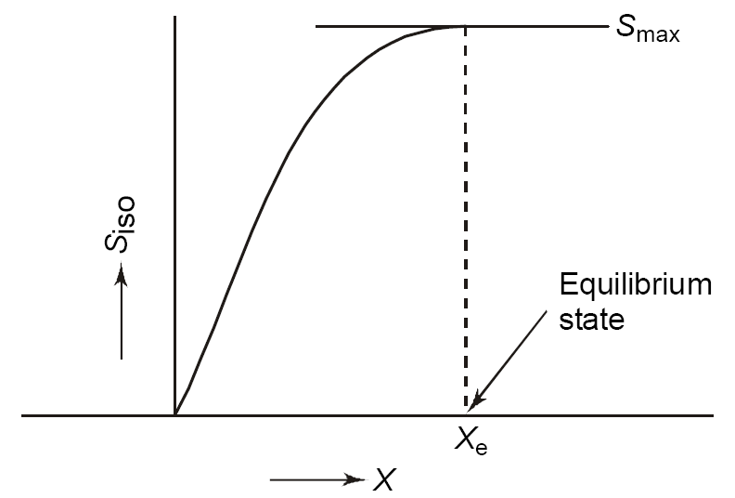

Slide 22
TdS equations
From the first law for an internally reversible process, we know that
This is known as the First TdS equation.

Slide 23
TdS equations
From the definition of enthalpy, we know that,
This is known as the second TdS equation.

Slide 24
TdS equations
Since the TdS equations are property relations, they are therefore independent of the type of the processes.
The Tds relations are hence, valid for both reversible and irreversible processes and for both closed and open systems.

Slide 25
Entropy change of liquids and solids
Liquids and solids can be approximated as incompressible substances since their specific volumes remain nearly constant during a process.
Thus, dv = 0 for liquids and solids.

Slide 26
Entropy change of ideal gases
For ideal gases we know that,
The entropy change for a process,

Slide 27
Entropy change of ideal gases
Usually, we assume average values of c_{p} and c_{v} in the above equations and thus can replace c_{p}(T) with c_{p,av} and c_{v}(T) with c_{v,av}.

Slide 28
Third law of thermodynamics
Entropy can be viewed as a measure of molecular disorder, or molecular randomness.
As a system becomes more disordered, the positions of the molecules become less predictable and the entropy increases.
The entropy of a system is related to the total number of possible microscopic states of that system, called thermodynamic probability p, by the Boltzmann relation.

Slide 29
Third law of thermodynamics
Boltzmann relation is expressed as
S=k lnp
Where, k = 1.3806 x 10⁻²³ J/K is the
Boltzmann constant.
From a microscopic point of view, the entropy of a system increases whenever the molecular randomness or uncertainty (i.e., molecular probability) of a system
increases.

Slide 30
Third law of thermodynamics
The entropy of a pure crystalline at absolute zero temperature is zero since there is no uncertainty about the state of the molecules at that instant: the third law of thermodynamics.
The entropy determined relative to this point is called absolute entropy.
A pure crystalline substance at absolute zero temperature is in perfect order, and its entropy is zero.

Slide 31
Entropy and energy transfer
An organized form of energy like work is free of disorder or randomness and thus free of entropy.
There is no entropy transfer associated with energy transfer as work.
The quantity of energy is always preserved during an actual process (the 1st law), but the quality is bound to decrease (the 2nd law).

Slide 32


Entropy and energy transfer
W_{sh}
Gas
W_{sh}
Raising of a weight by a rotating shaft does not generate entropy, and so energy is not degraded during this process (if we assume frictional effects can be neglected).
The work done on a gas increases the entropy of the gas, and thus energy is degraded during this process.

Slide 33
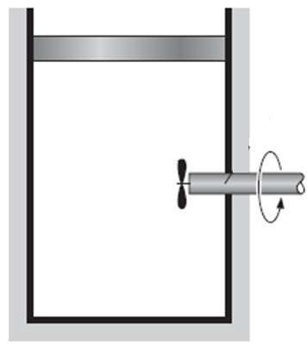
Entropy is not transferred with work
Entropy generation by friction
No entropy accompanies work as it crosses the system boundary. But entropy may be generated within the system as work is dissipated into a less useful form of energy.

Slide 34
Entropy and energy transfer
This decrease in quality is always
accompanied by an increase in entropy.
Heat is a form of disorganized energy, and
hence, there is increase in entropy with
heat.
Processes can occur only in the direction of
increased overall entropy or molecular
disorder.
That is, the entire universe is getting more
and more chaotic every day.

Slide 35
Entropy and energy transfer
Cold body
Entropy increases
Hot body
Entropy decreases
Heat
During a heat transfer process, the net
entropy increases.
This is because, the increase in the entropy
of the cold body is more than the decrease in
the entropy of the hot body.

Slide 36
Entropy and energy transfer
Work is entropy-free, and no entropy is transferred by work.
Closed systems
Energy is transferred by both heat and work, whereas entropy is transferred only by heat (closed systems).
Only energy is exchanged during work interaction whereas both energy and entropy are exchanged during heat transfer.
Open systems
Entropy transfer in open systems: heat and mass flow.

Slide 37
Entropy balance
Entropy balance for any system undergoing
any process is:

Slide 38
Entropy balance

Slide 39
Entropy balance

